Slide 1
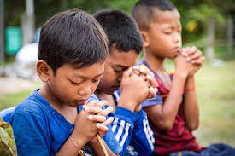
Worship
25th January 2021

Slide 2
What does it mean to you to be part of our school community?
What do you like about being part of the community?
What would you miss if you were no longer part of our group? Answer on the next slide.

Slide 3
Hello Easington Primary Academy children
Even though we are all busy at the moment either doing our learning at home or in school, remember
that we all belong to the same community - Easington Primary School.
We are all part of a team that support and care for each other and we make sure that we all can be the best people that we can be.
Remember that ………
We are a community working in harmony to achieve our God given potential

Slide 4
I like being part of the school because..
What I would miss would be…….

Slide 5
We are all valuable members of our community yet we are all so very different. It is good to be
different. Can you think of lots of ways that people/children are different? Write down some of those
ways here…….
Differences

Slide 6
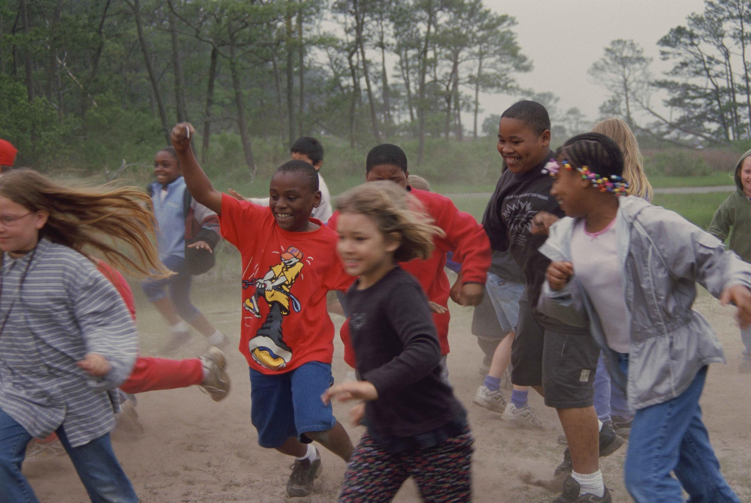
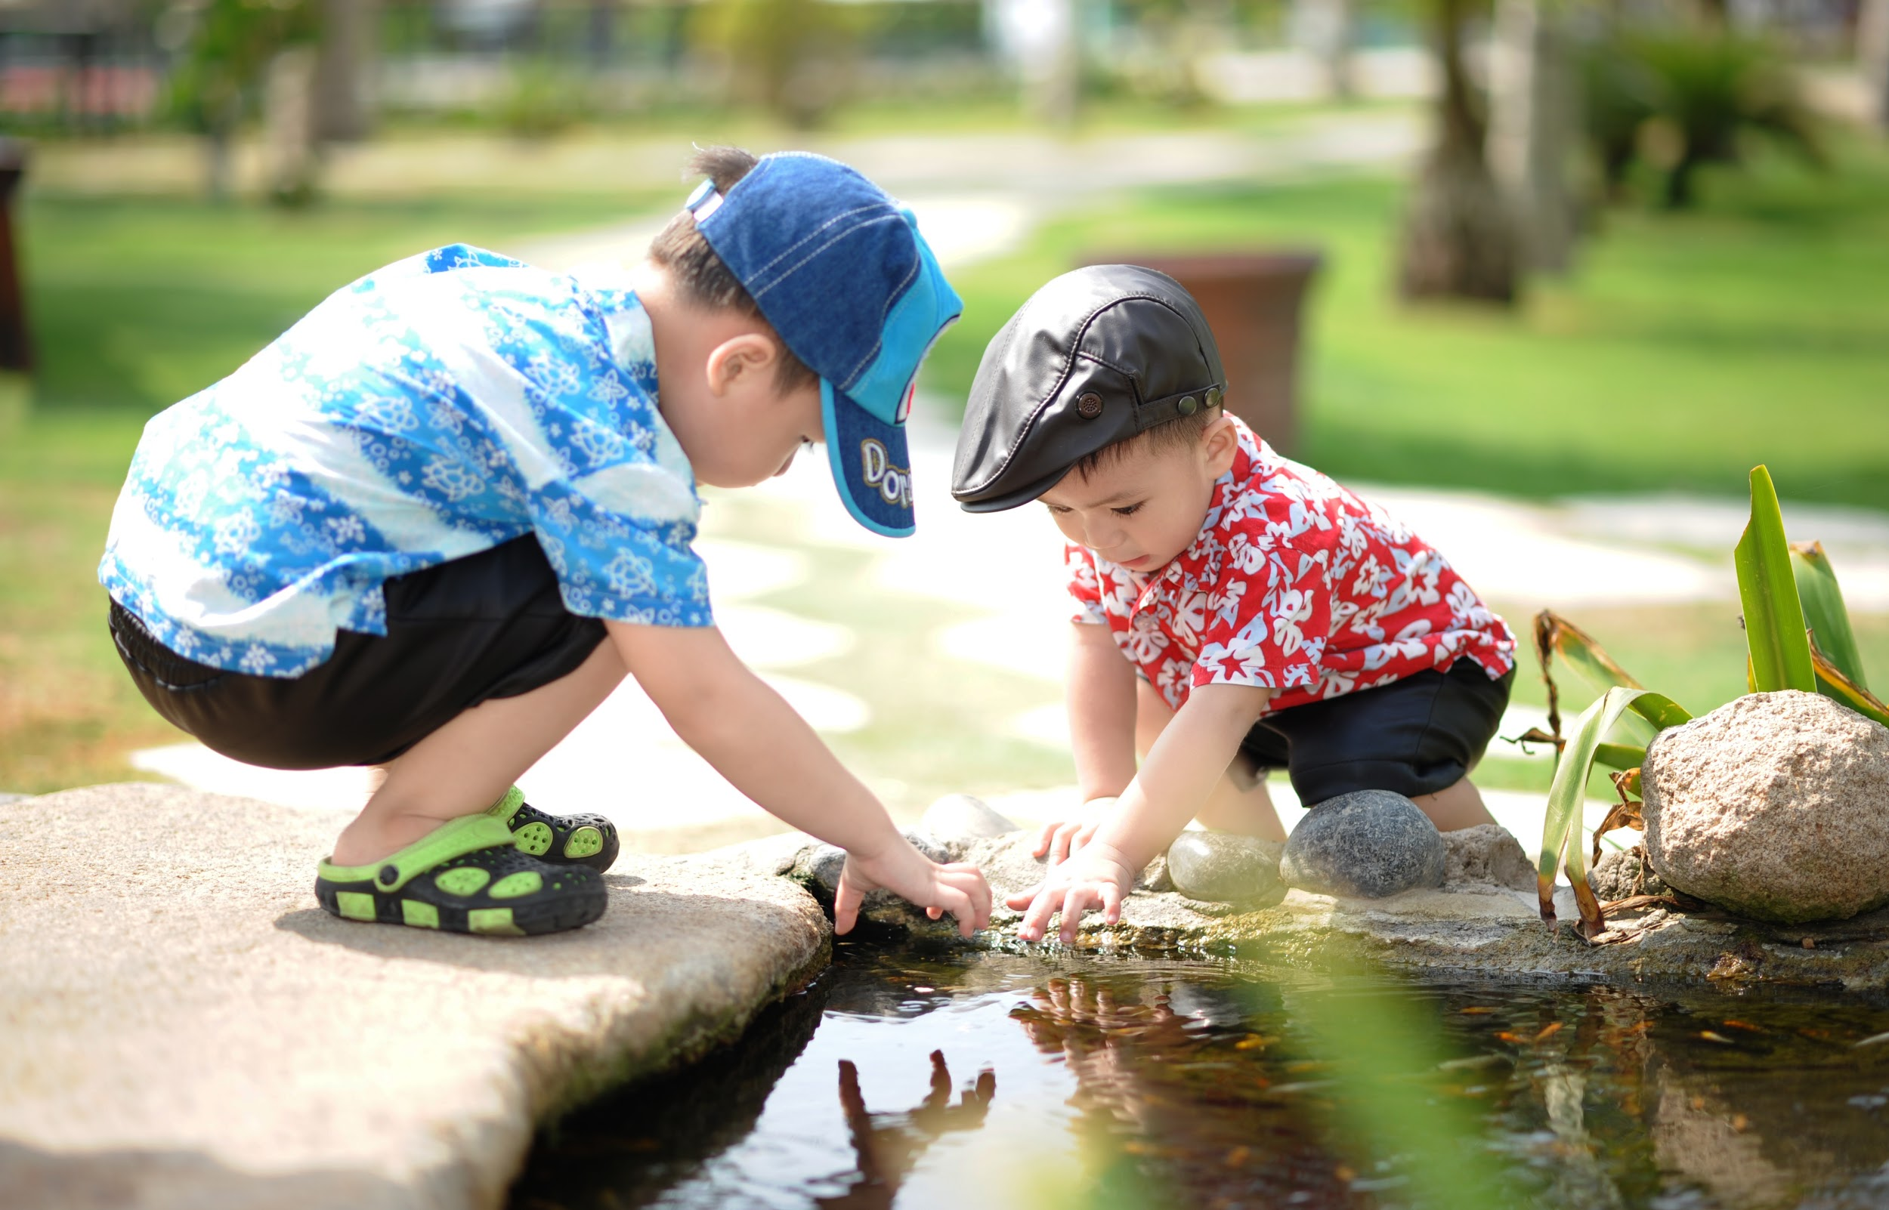
Make a poster showing what you bring to our school community.
Why are you important? What do you do to help, support or care for our school community?

Slide 7
Prayer
Dear God,
Thank you for making us all different. Help us to understand that because of
our differences that makes us special. We all have a part to play in making
our school community a caring, supportive and helpful group of which I am
part of. Please look after all our children whether they are in school or at home
learning.
Thank you God
Amen.

Slide 8
Worship
Tuesday 25th January
Hopefully, you have had some time to think about how important you are to our school community.
If not, try and make the poster sometime this week and then find a way to share it with Mrs Verity.

Slide 9
Our value this week is generosity.
What is generosity?
Press here

Slide 10
Let’s look at generosity as giving your time to someone.
How can you show generosity at home or at school by giving someone some time?
What can you do that will either support or make someone feel special because you have given them some time?
Fill out the cloud on the next page to show what you could do.
Eg read a story to a younger brother/sister. Help your mum/adult to do something.

Slide 12
Dear God,
Please help us to be generous by giving some of our time to someone else.
Show us how this can make that person feel special by sharing time with them.
Help us to improve our relationships with others through the giving of time.
Thank you God
Amen.

